Slide 1
Augmented Reality Physical Therapy
Group Number: 21

Slide 2
Administrative Introduction
Sponsor
Todd Sinclair, 9 Degrees of Human
Team Members
Alex Alvarez: Website Front-end, Camera, HoloLens, Database
Alfredo Quiroga: Website Front-end, Camera
Joe Hummel: REST API, Website Back-end, Database
Kaike Ferreira: HoloLens, Database
Logan Harvell: HoloLens, Server, REST API
Mechanical Engineers
Kayla Bitner, Geovani Colberg, Justin Velasquez, Alejandro Zelaya
Notes:
Kaike

Slide 3
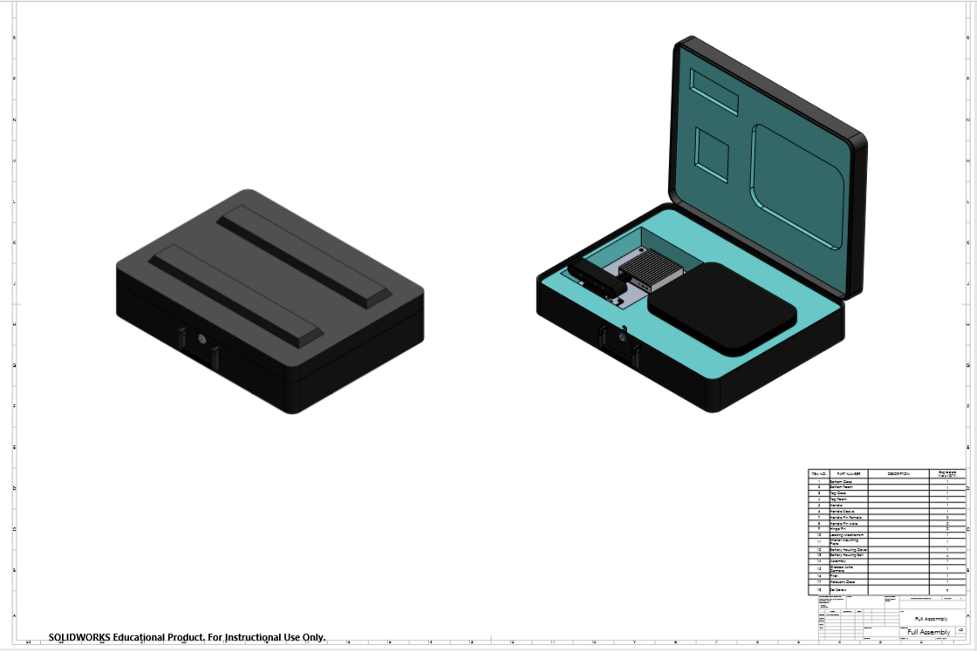
Mechanical Engineer’s ARPT Case

Slide 4
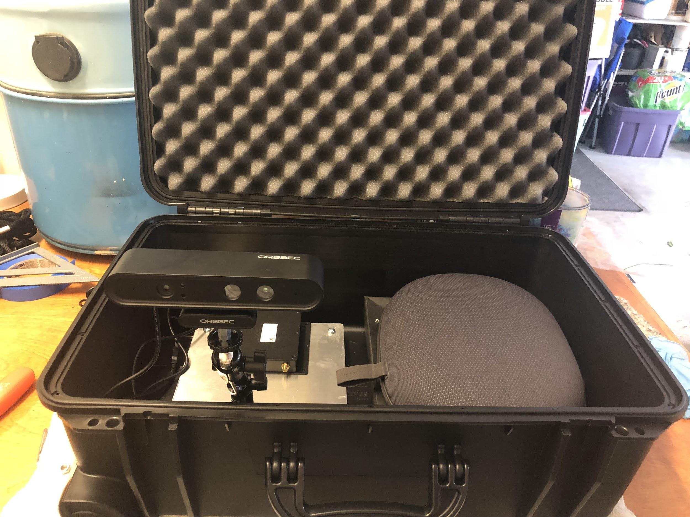
Mechanical Engineer’s Prototype Case

Slide 5
Problem Statement
Making it easier for patients to perform physical therapy exercises without having to meet with a physical therapist face-to-face
Correctly doing exercises without supervision
Recording data accurately for the physician
Allowing patients to perform exercises at their convenience
Lack of motivation to perform exercises at home
Notes:
Kaike

Slide 6
Solution
Utilize augmented reality to promote proper exercise technique safely and accurately
Augmented reality devices can be used at home
By using technology data can be tracked accurately and automatically without the presence of a therapist
Create an interactive environment to motivate users
Using a web application for a physician to easily access patient data
Notes:
Joe

Slide 7
Requirements
Web application in .NET and C#
Microsoft SQL Server Database to store patient information
Patient data uploaded to site after exercise completion
HoloLens application to allow patients to do exercises
Hosted on Azure
Notes:
Joe

Slide 8
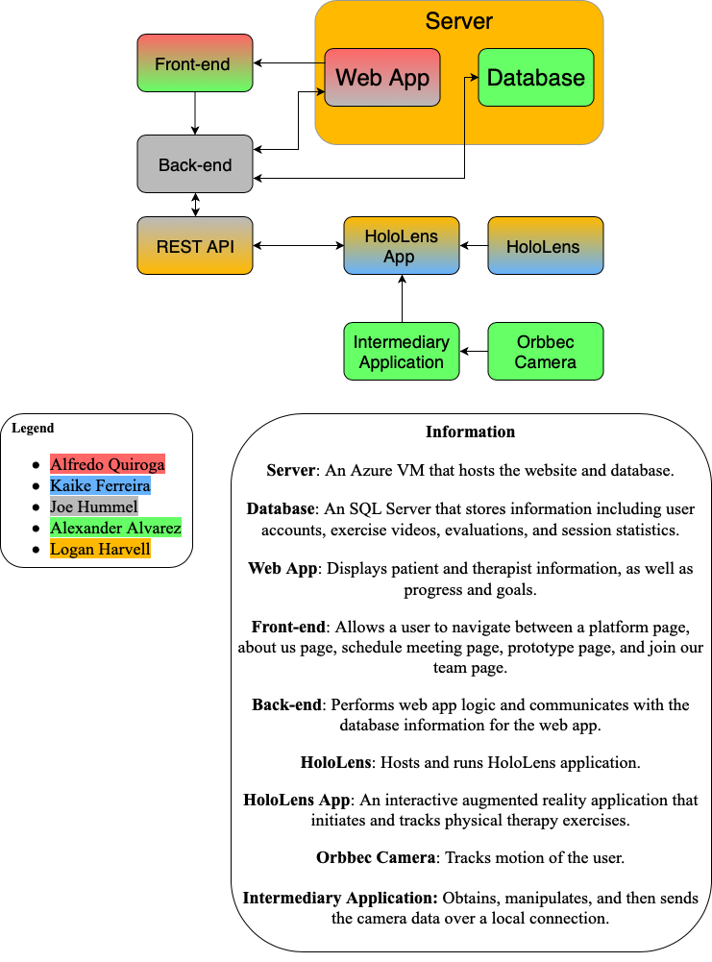
Project Structure
Notes:
Alex

Slide 9
Design Approach
Orbbec Camera
Sends motion tracking data through a computer application
Utilizes a local network socket connection
HoloLens Headset
Augmented reality headset for interactive holograms from Microsoft
Hosts and runs native application enabling and tracking home physical therapy exercises
Server - Azure VM running Windows Server 2016
Database, Microsoft SQL Server
Web application, hosted using Internet Information Services (IIS)
ASP.NET MVC web application
REST API
Notes:
Alex

Slide 10
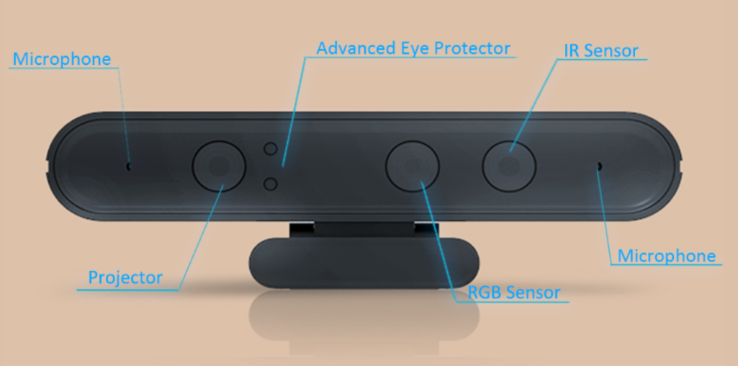
Camera
The motion sensing will be done by the Orbbec Astra Pro.
Notes:
Alex

Slide 11
Camera Application
Astra SDK camera framework
Written in C++ to target the Win32 platform and to run on an external Windows 10 PC to send data over the network to the HoloLens
This application will serve as a network interface to send data joint data over the local network using IP addresses
Notes:
Alex

Slide 12
Camera Application
This application has the capability to also detect joint orientation as well as the depth of each joint
It will not have a GUI and will be a simple terminal application meant to run in the computer that will be given to the users in the final product - for testing purposes we are running it on our own PCs with Windows 10
Notes:
Alex

Slide 13
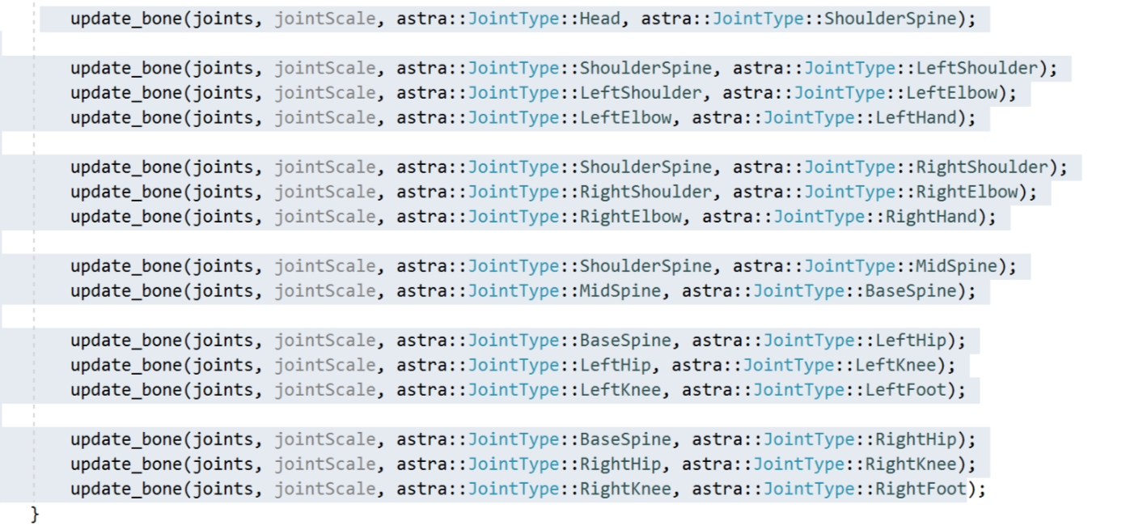
Camera Application
The camera software stores joint positions that we will use for our movement detection algorithm
Notes:
Alex

Slide 14
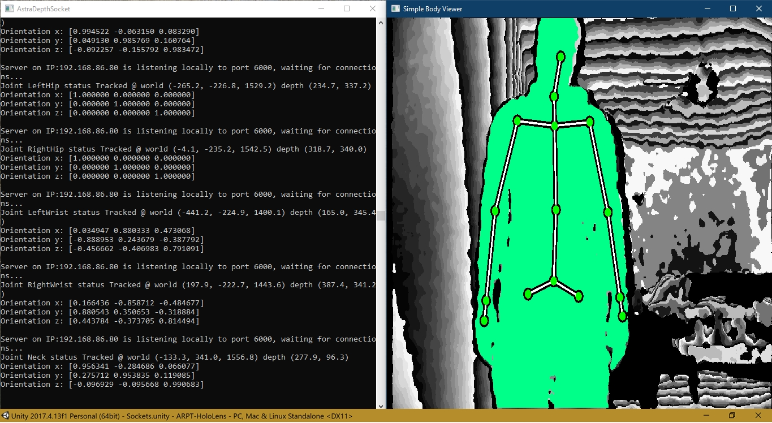
Camera Application
Server side: detects joints and orientation and senda data and sending over the network using the TCP protocol

Slide 15
Camera Application
Client Side - Joint data being received from the camera

Slide 16
HoloLens Application
Development
Written in C# with Unity3D as a Universal Windows Platform application, specifically targeting the HoloLens
Much of the application utilizes Unity frameworks and the HoloToolKit provided by Microsoft
Utilizes REST API to communicate with the web app and server, enabling data transfer
The HoloLens app is also capable of receiving motion tracking data from our camera application over a local network connection
Notes:
Logan

Slide 17
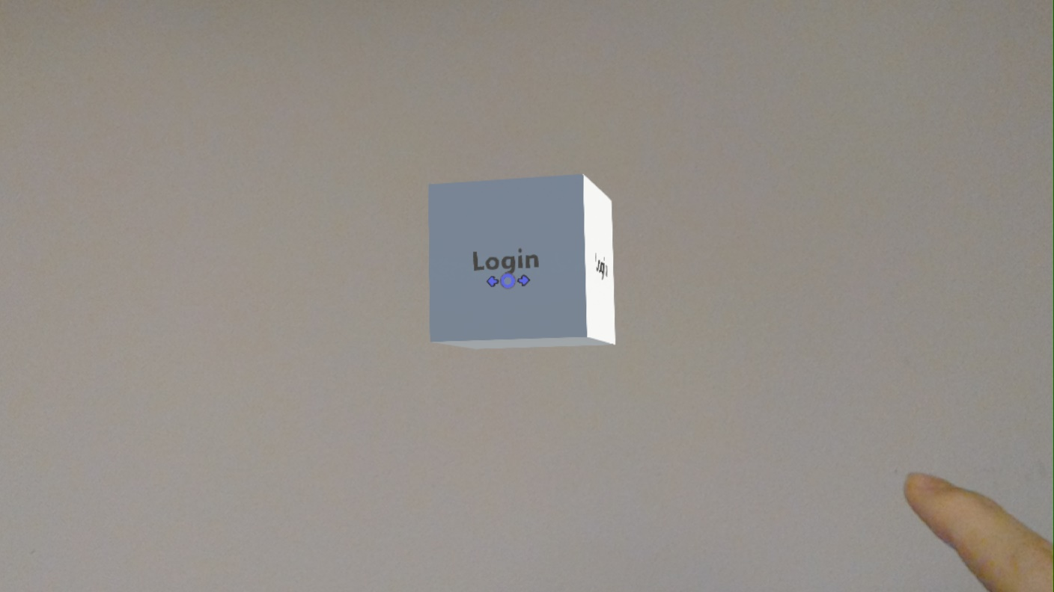
HoloLens Application Flow
First the user is presented with a cube as the main menu interface
The user can rotate the cube to select different options
It remains within the user’s vision
Notes:
Logan

Slide 18
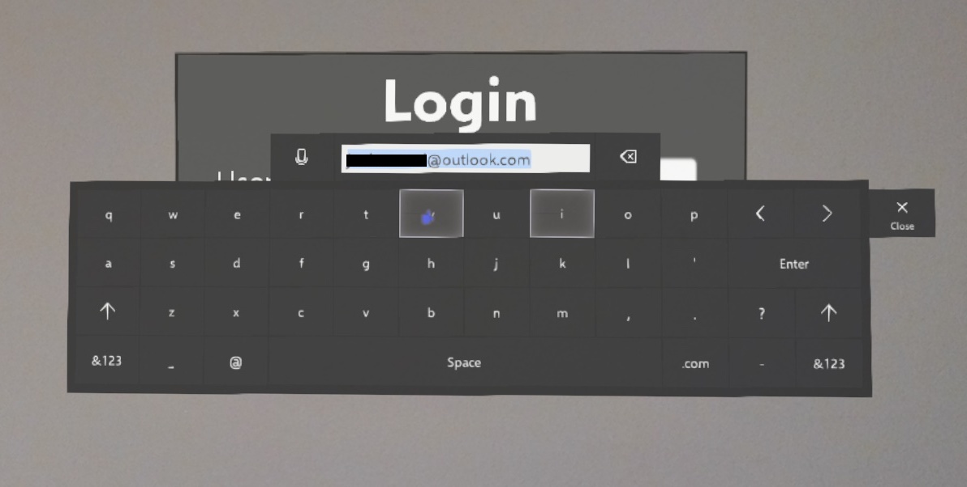
HoloLens Application Flow
If the user is not logged in, login is the only option
The user fills in the fields with their web application credentials
Next an POST request is made to our REST API
Notes:
Logan

Slide 19
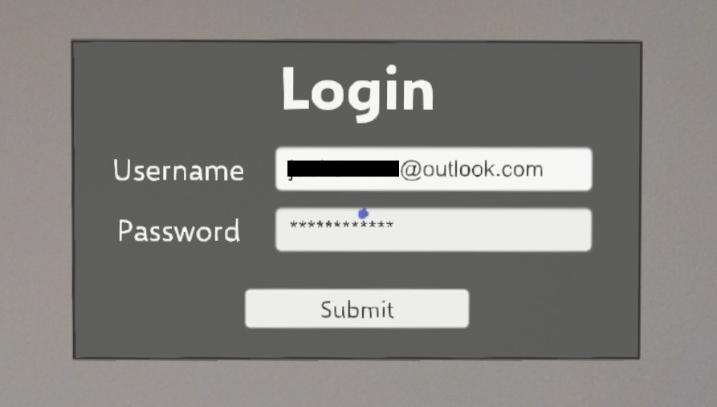
HoloLens Application Flow
Notes:
Logan

Slide 20
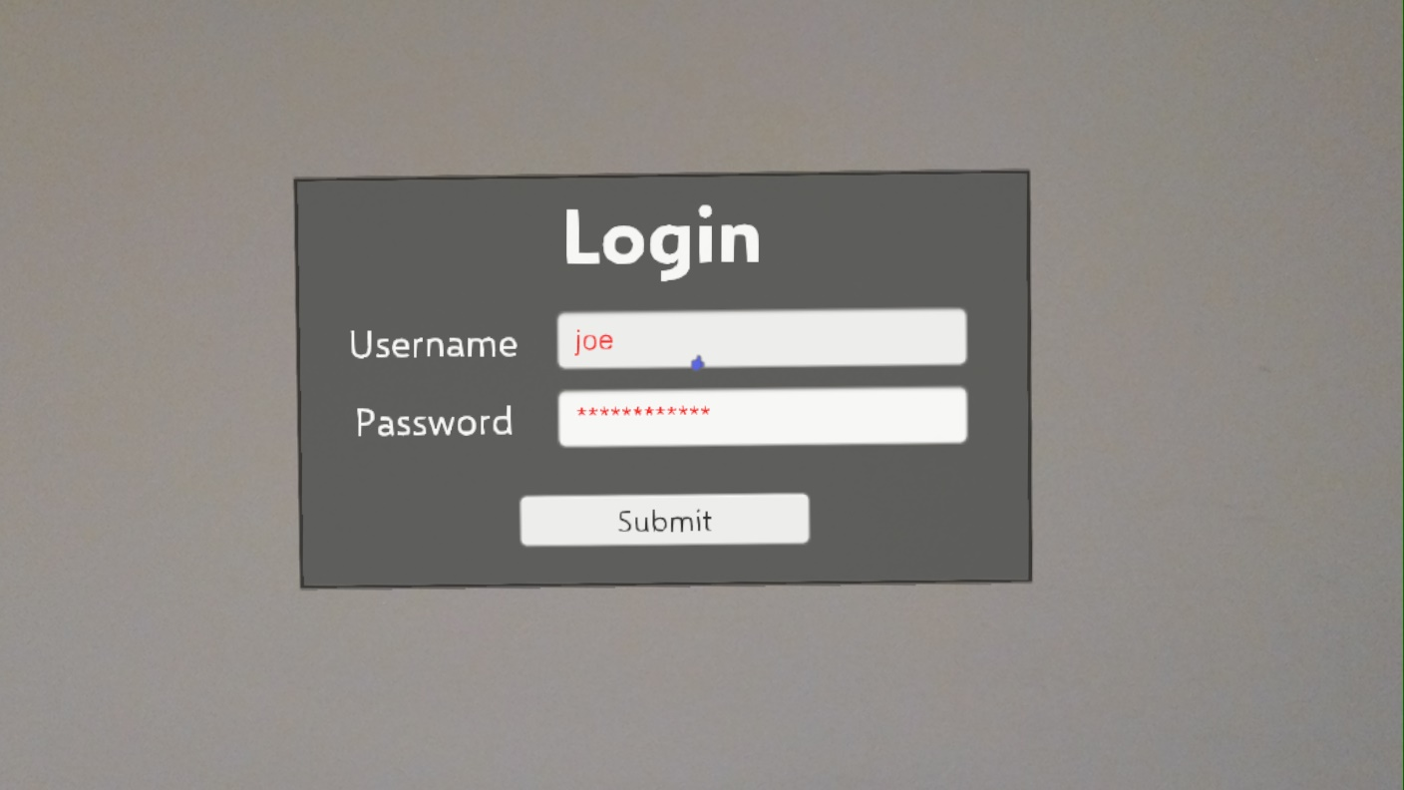
HoloLens Application Flow
If the username and password do not match an existing user, then the text is colored red
The user is free to re-attempt their login immediately
Notes:
Logan

Slide 21
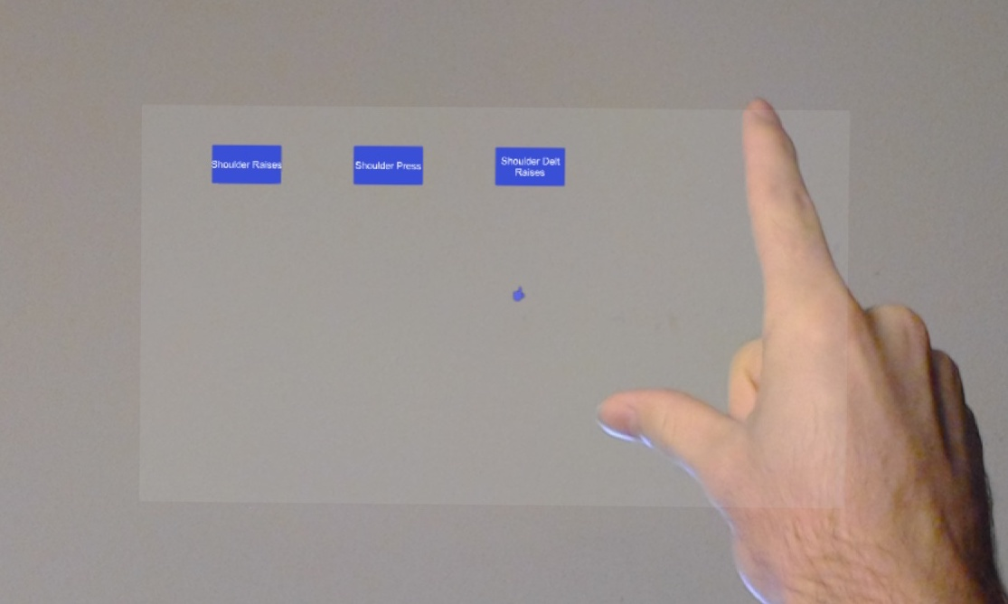
HoloLens Application Flow
Once logged in, the user’s customized list of exercises populate an exercise menu
In this case, there are three shoulder exercises for the patient listed
Notes:
Logan

Slide 22
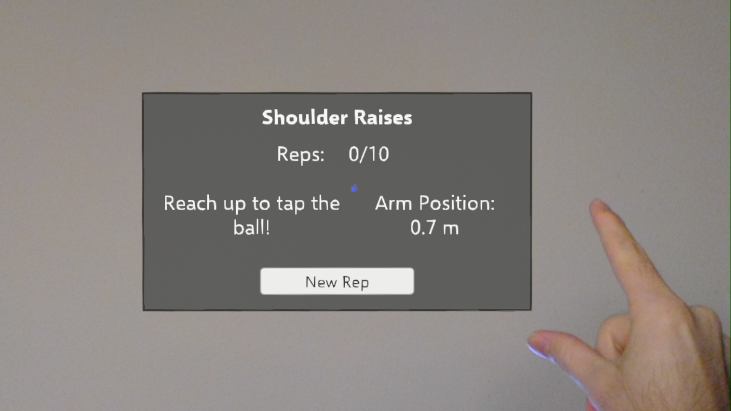
HoloLens Application Flow
Once an exercise is selected, the user is guided through an exercise
The prototype demonstrates Shoulder Raises, which require a user to reach above their head
Notes:
Logan

Slide 23
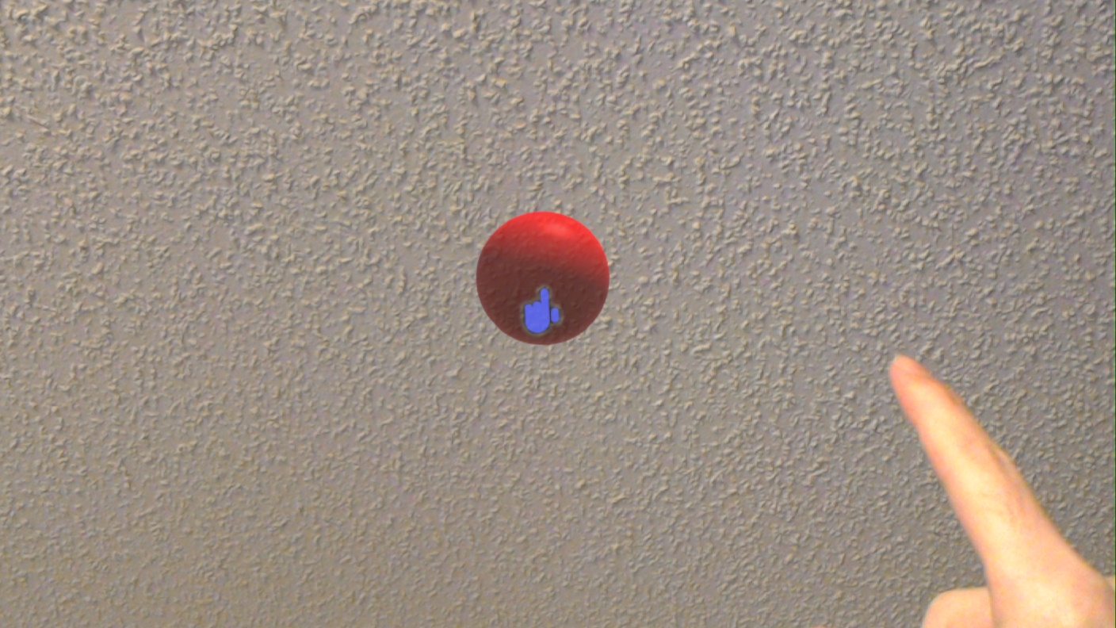
HoloLens Application Flow
Notes:
Logan

Slide 24
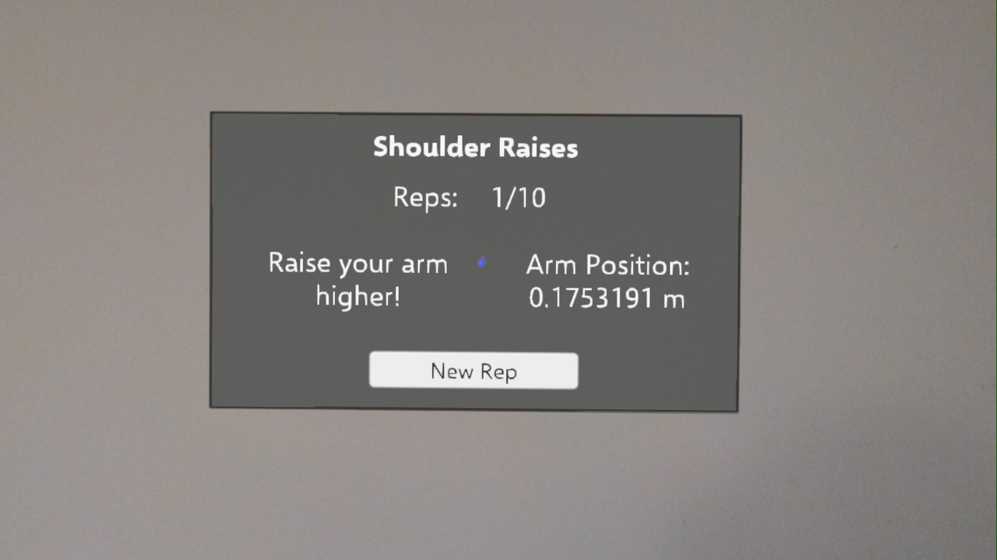
HoloLens Application Flow
The app provides guidance when the user needs to reach higher
Their last attempt is available for reference
Notes:
Logan

Slide 25
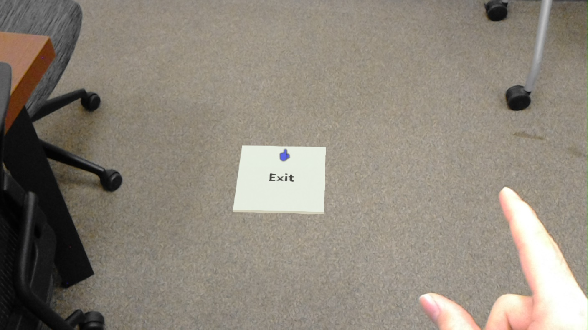
HoloLens Application Flow
At any time the user is able to exit back to the list of exercises if needed
Notes:
Logan

Slide 26
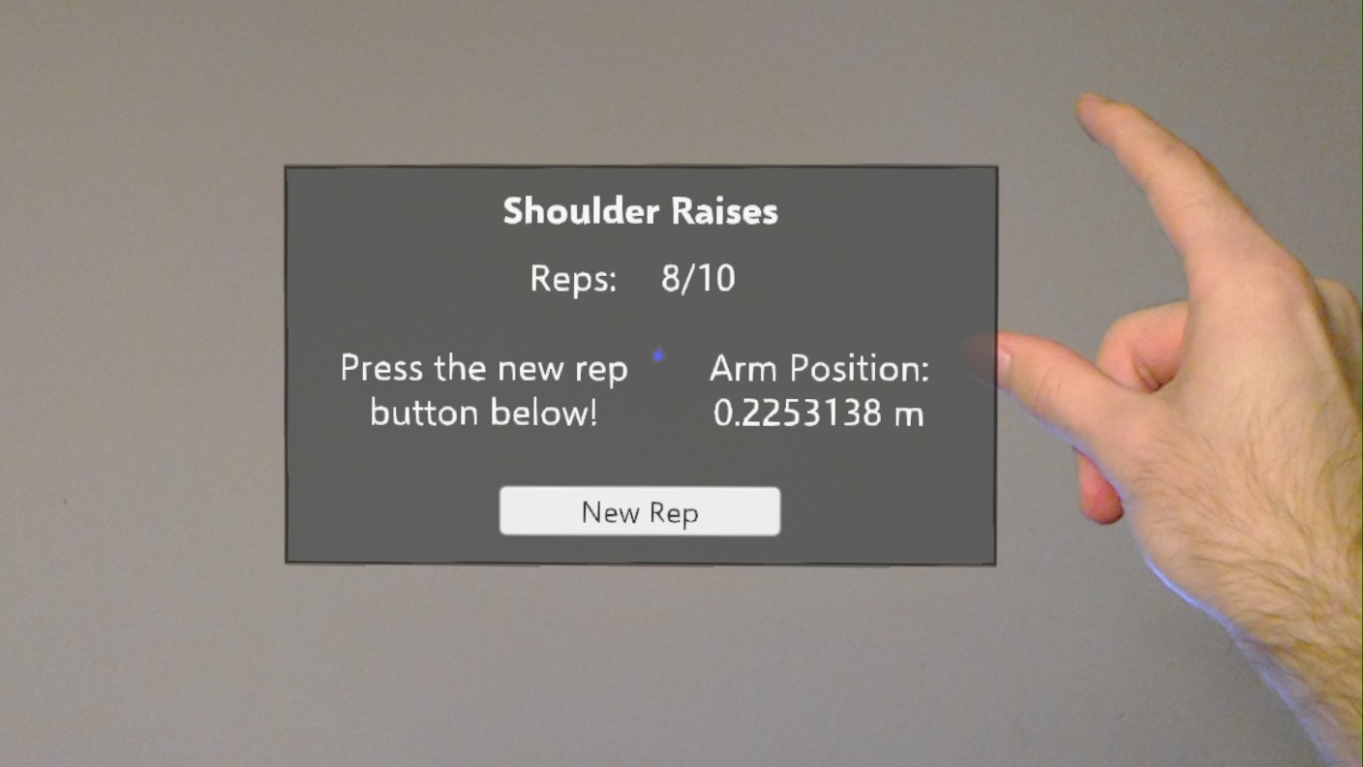
HoloLens Application Flow
The total number of repetitions are tracked out the exercise total
Currently, the app tries to ensure that the user lowers their reach by manually requiring a rep reset
Notes:
Logan

Slide 27
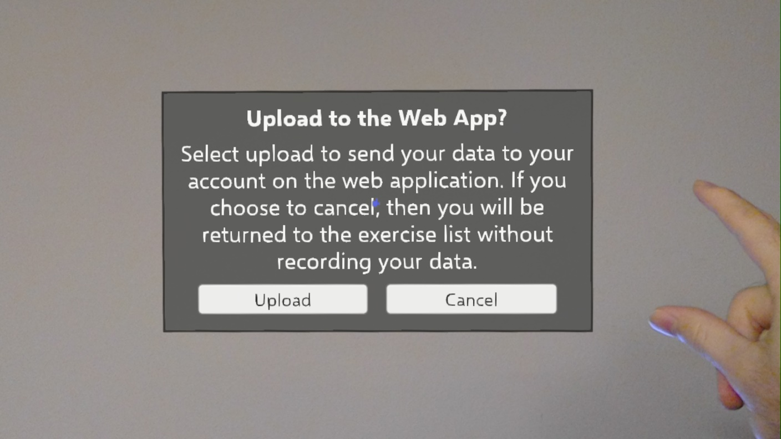
HoloLens Application Flow
After completion, the user may upload their stats to their account
If so, then a POST is made to the REST API
Both options bring the user to the exercise menu
Notes:
Logan

Slide 28
Server and Database
Server
The server consists of a single virtual machine hosted on the Microsoft Azure cloud platform running Windows Server 2016
It is set up as a web host using Microsoft’s Internet Information Services and is also set up for FTP to act as a file server
Also hosts the database
Database
Microsoft SQL Server
Contains tables for users, videos, exercises, and subscriptions
Notes:
Logan

Slide 29
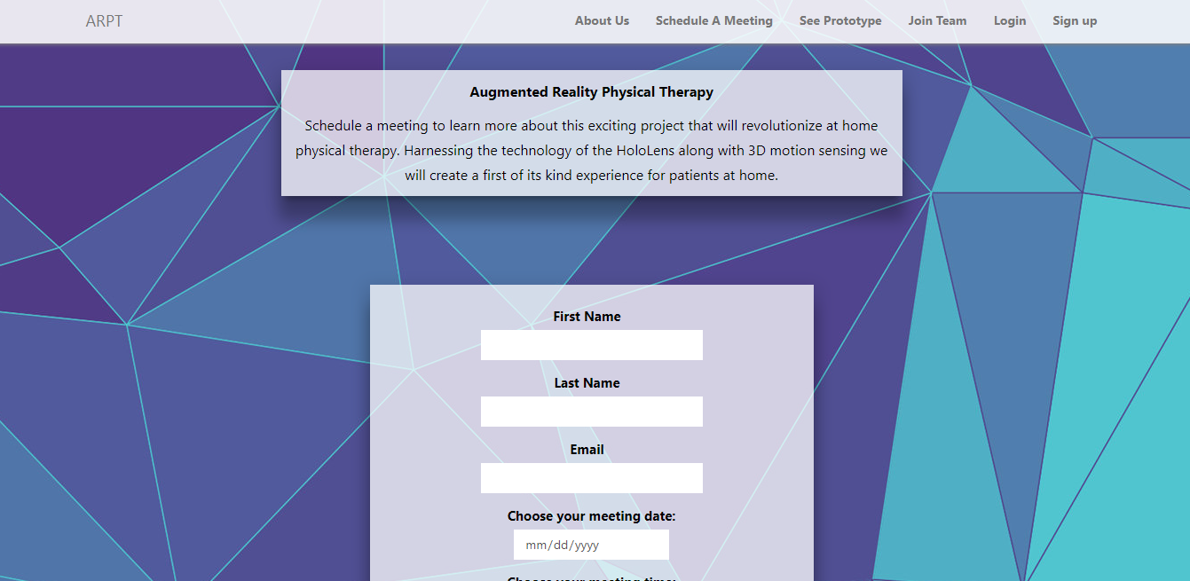
Web Application Front-end
Custom CSS and the BootStrap library helped create a fluent design interface
Different sections of the site are separated and labeled in the navigation bar at the top
Notes:
Alfredo

Slide 30
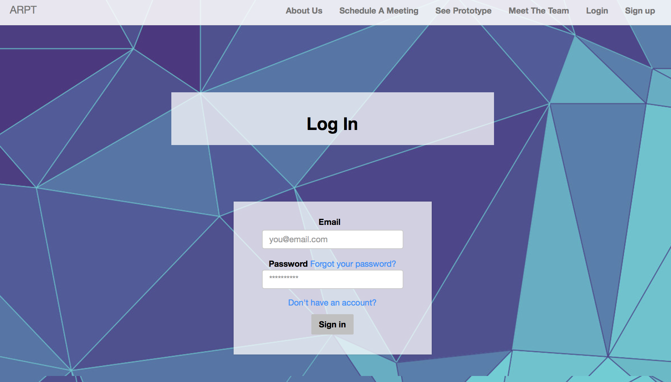
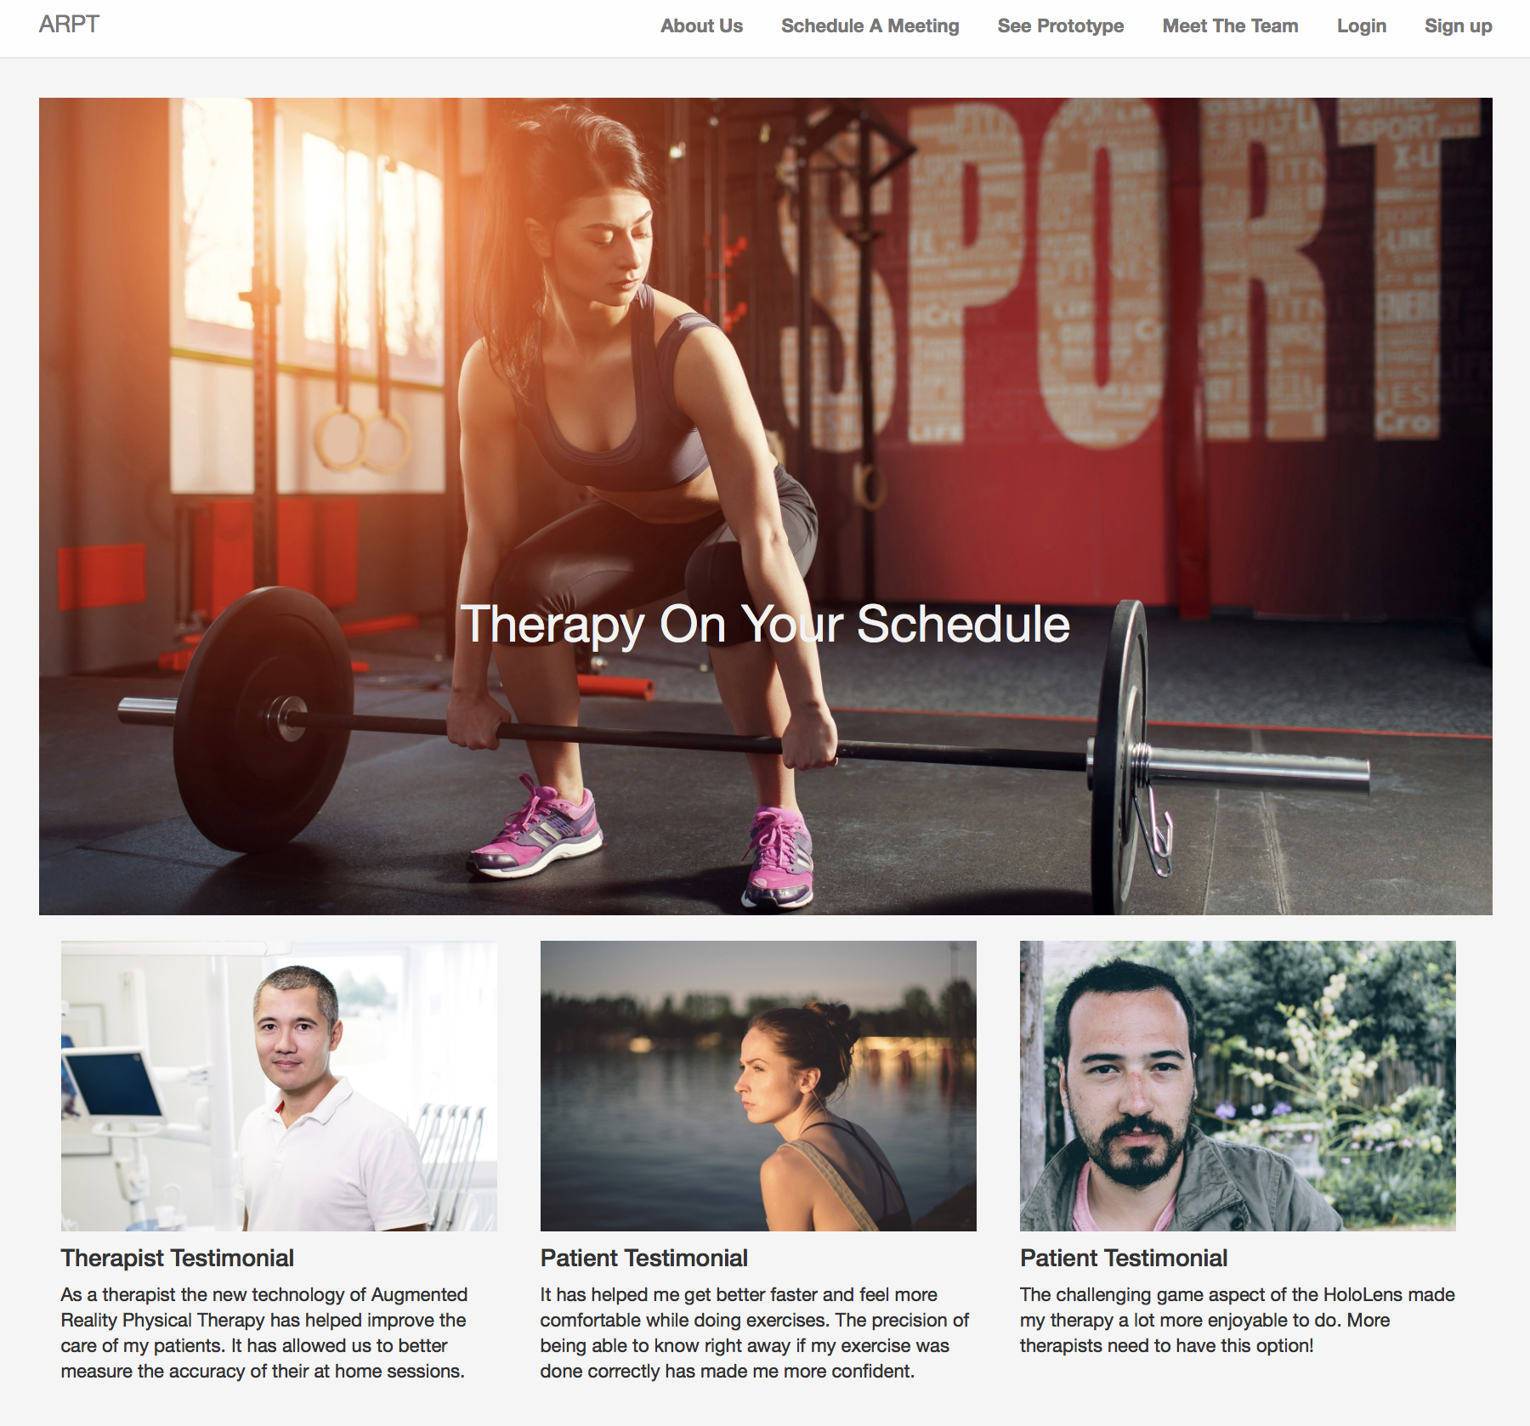
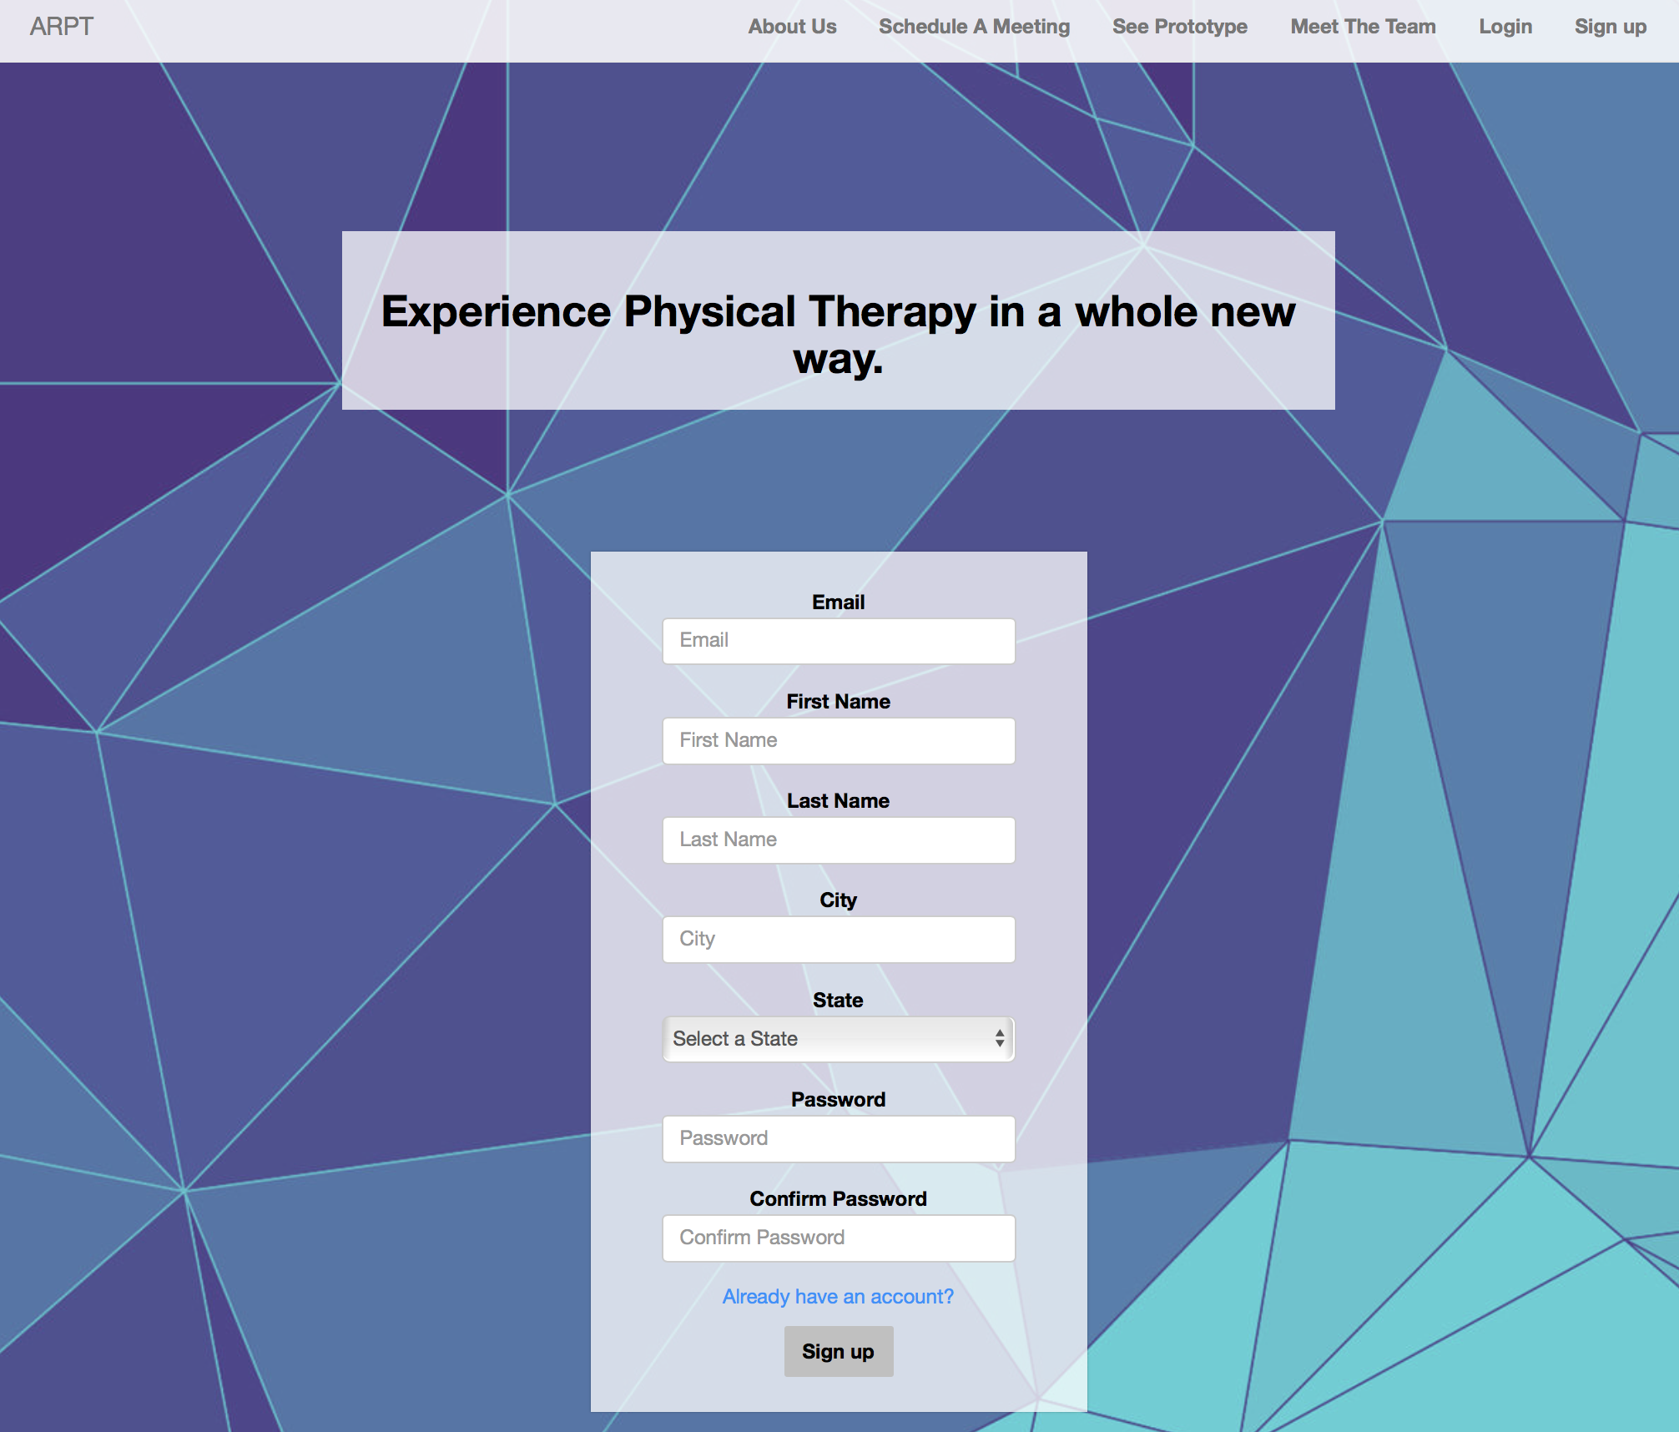

Slide 31
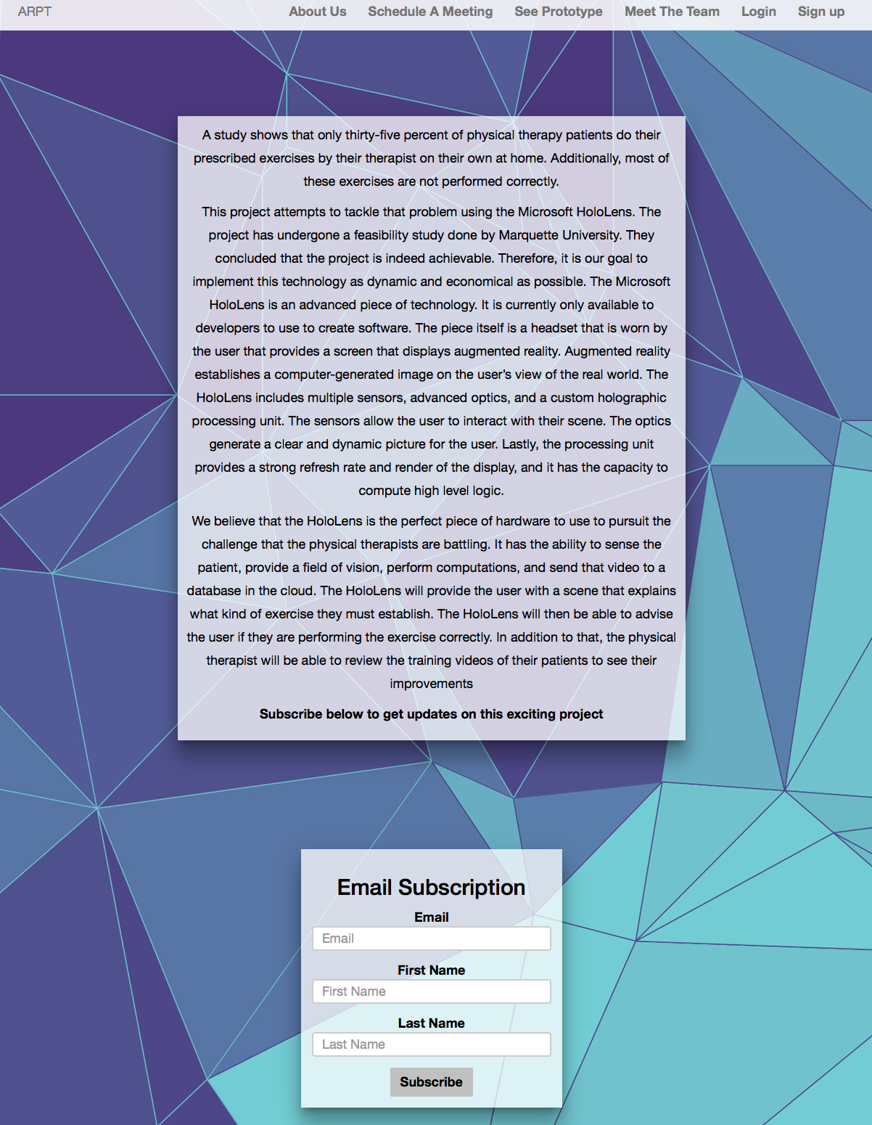
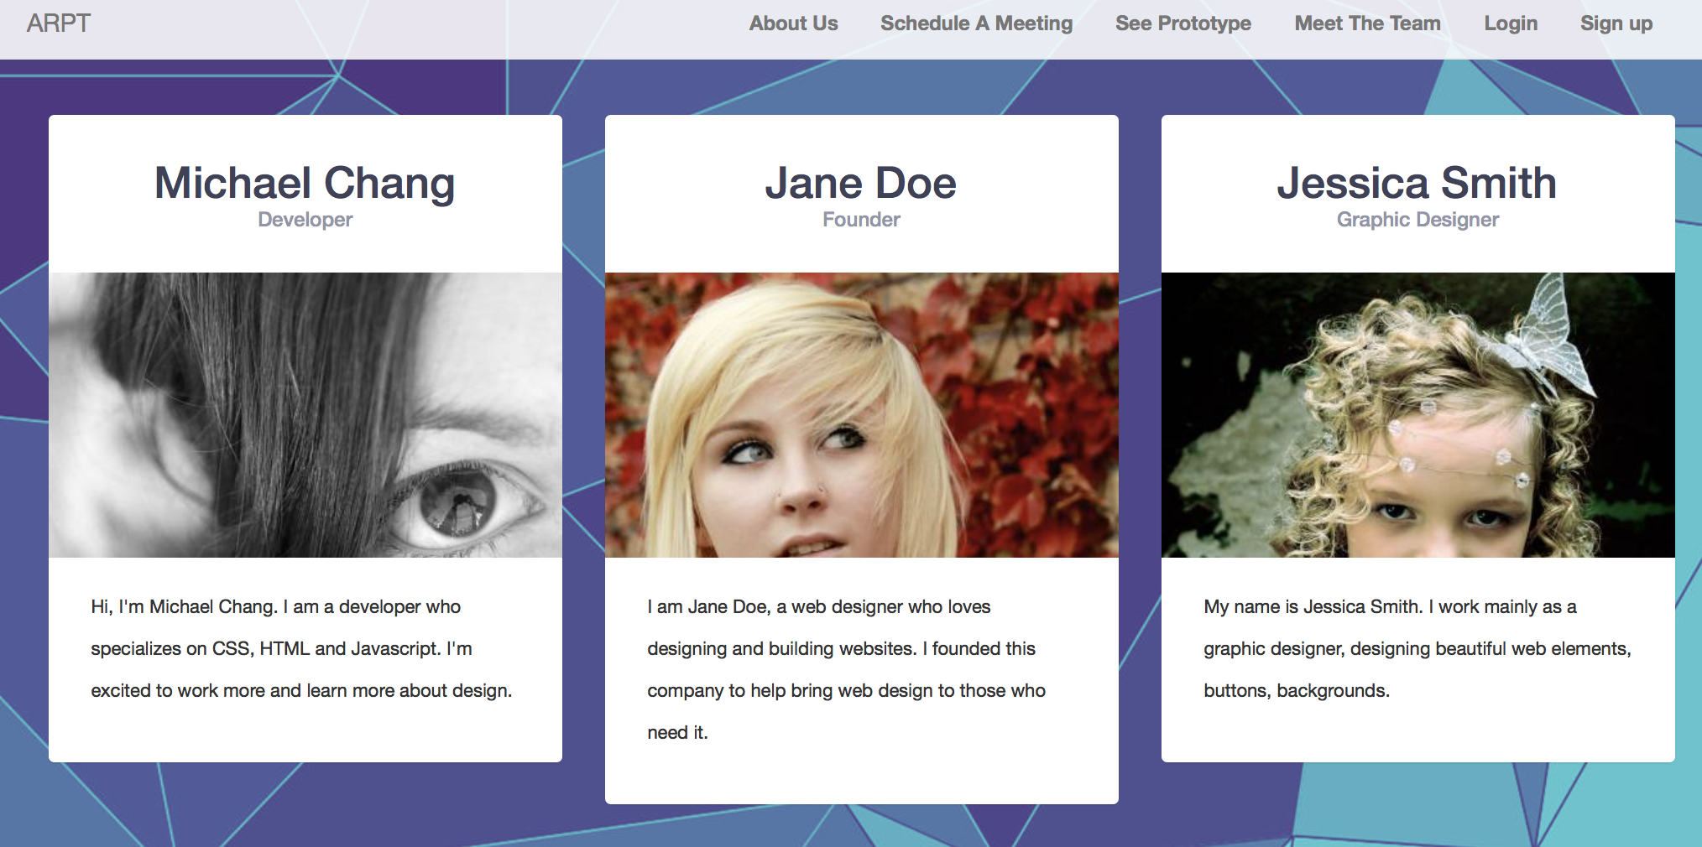

Slide 32
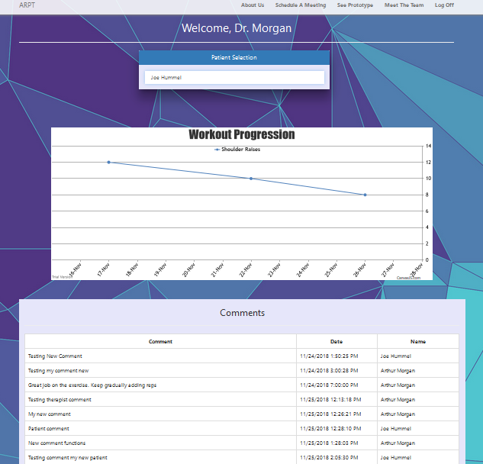

Slide 33
Web Application Front-end
Usability!!
Once logged in users/patients will be able to see any comments from that the user has left
Physical therapist will be able to see a list of their patients that use the application and the statistics of their exercises as well as make comments on the page
Notes:
Alfredo

Slide 34
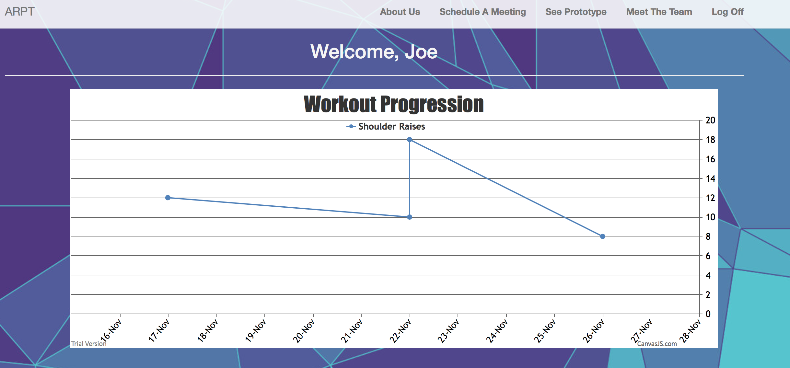
Web Application Front-end
Using a graph to display patient progress.
Notes:
Alfredo

Slide 35
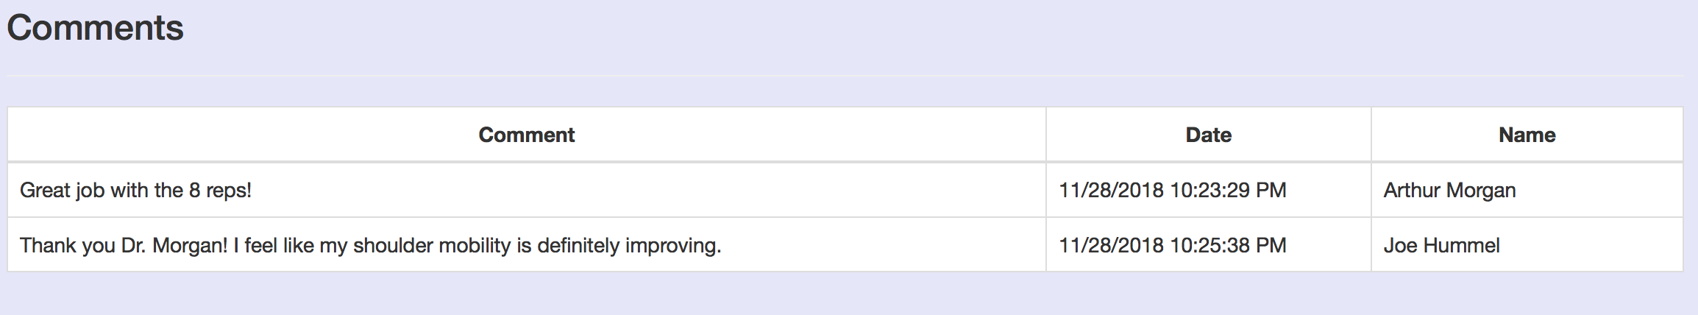
Web Application Front-end
Communication between patient and therapists.
Notes:
Alfredo

Slide 36
Web Application Back-end
Framework: ASP.NET Core 2.0
Design: Model-View-Controller (MVC)
Efficiently handles many different actions (Login, Signup, etc.)
Takes input from the View
Notes:
Joe

Slide 37
Security
Hashing: Password-Based Key Derivation Function 2 (PBKDF2)
JSON Web Token (JWT) for authentication
Stored Procedures
Input Validation
Notes:
Joe

Slide 38
Budget
HoloLens: $3,000
Camera (Orbbec Astra Pro): $149.00
Azure: $50/month
Computer: ~$500 ($0 during development)
Notes:
Joe

Slide 39
Difficulties and Accomplishments
Difficulties
Pioneering new technology, very small foundation and prior experience to work with
Halfway camera change, Lack of API documentation for the new camera
Developing for the HoloLens has many quirks, and the documentation is quickly outdated
Accomplishments
Server is setup and running, hosting a file server, database, and the web application and it is capable of scaling due to Azure’s flexibility
Web Application is attractive, functional, and deployed to the server for easy access, and provides a solid foundation for future enhancements
HoloLens application is up and running, with working API calls and camera connection, it also established an overall user flow with a codebase prepared for tweaks and expansion
Camera application obtains, converts, and sends motion tracking data over a local network

